Slide 1
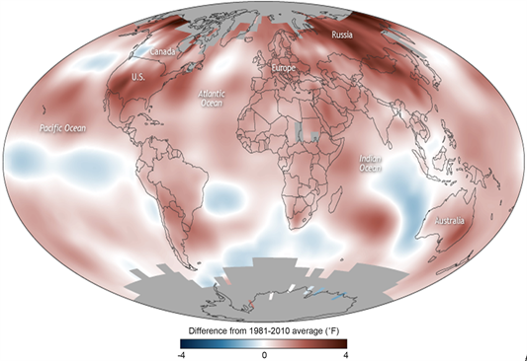
Yearly Global Climate Temperature Changes
Project Team Members: Project Advisor: Dr. Toni Holden-McGee
Brandon Swanson
Enxhi Merkaj

Slide 2
Introduction
Globally we have seen temperature increases in most parts of the world, Alaska, northern and western hemispheres. While some parts of the world are heating up annually on a modular scale this data research provides data findings, and graphical results of global temperature changes over the past 20 years in the hottest and coldest parts of the world.

Slide 3
Hypothesis
Examining weather datasets and identifying the 10 hottest and coldest places globally and to answer the question, are these global places getting hotter, colder and to what temperature differences over the past 20 years? Additional questions were answered during the studying of various data sets during the research period

Slide 4
Research Questions
Which countries have seen the highest and lowest changes in temperature between 2000-2023?
What might be contributing to these extremes?
Are these countries getting warmer or colder?
How has the temperature changed, is there a pattern and how much deviation is it?
Is there a correlation between population and climate change?
Based on the given dataset history, can we predict what the temperature in these places would be next year?

Slide 5

Research Analysis
Utilizing open-source tools and datasets sourced from Kaggle, our analysis revealed several compelling insights into the rapidly increasing temperature changes in global locations.

Slide 6

Open-source Tools
Kaggle
Jupyter Notebook
ThePhoto by PhotoAuthor is licensed under CCYYSA.

Slide 7
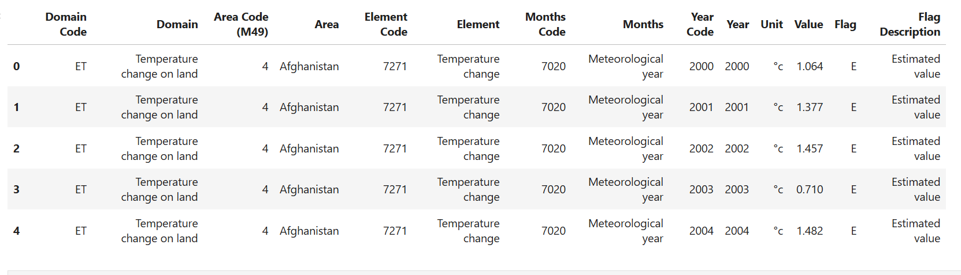
Dataset
Columns: 10
Rows: 5,000

Slide 8
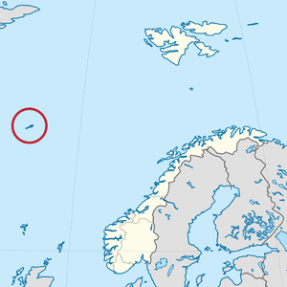
Findings
The top 10 places with the highest temp. change
The top 10 places with the lowest temp. change
Over the course of a 20 year period
Most rapidly changing climate location
ThePhoto by PhotoAuthor is licensed under CCYYSA.

Slide 9
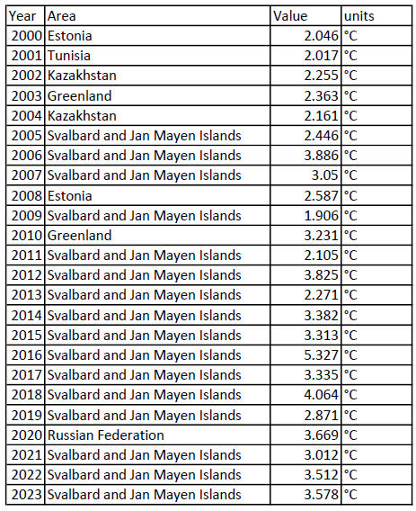
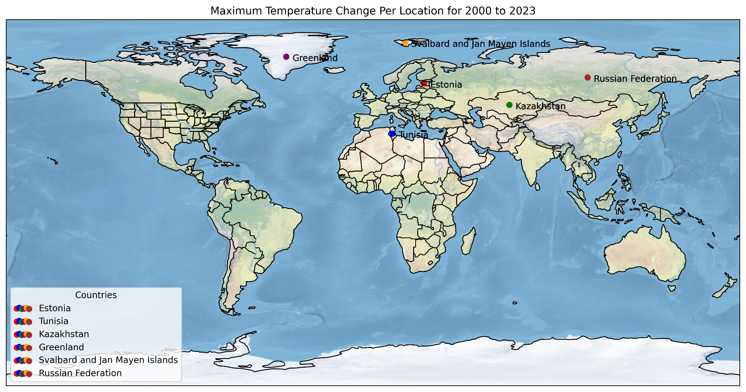
Graphical Data
Map Produced Using Cartopy and Jupyter notebook with a dataset derived from the FAOSTAT dataset

Slide 10
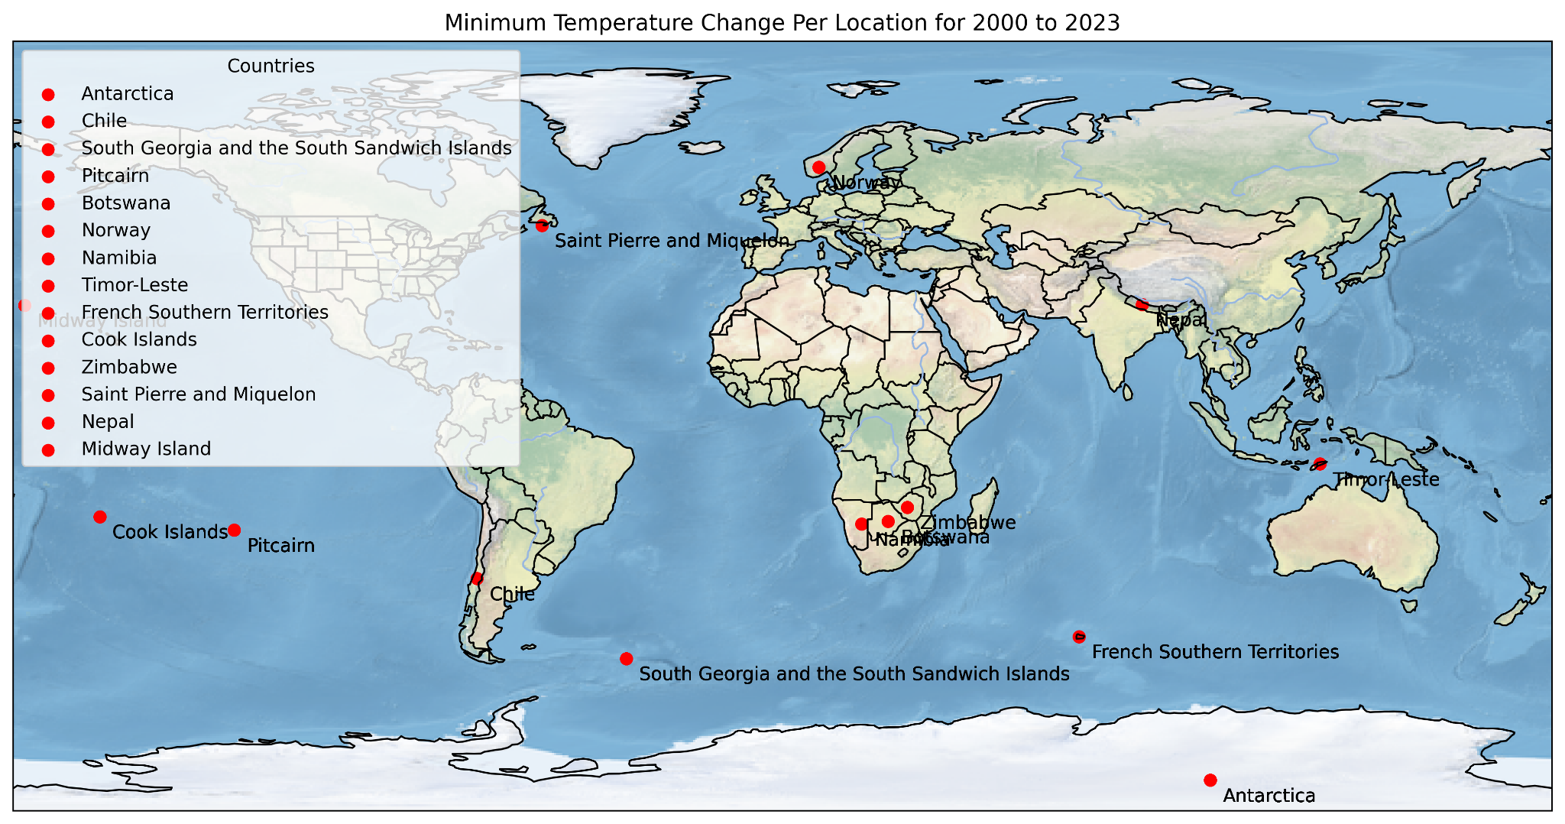
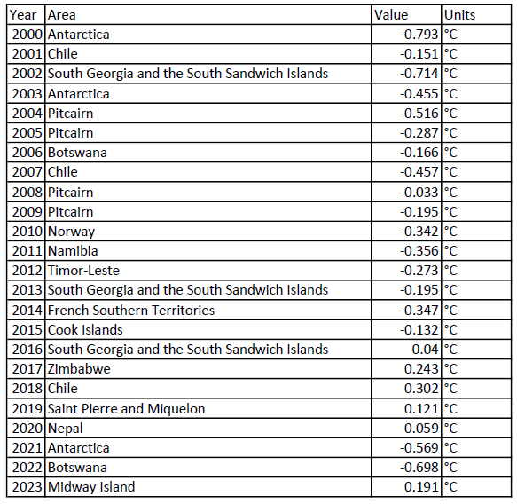
Graphical Data
Map Produced Using Cartopy and Jupyter notebook with a dataset derived from the FAOSTAT dataset

Slide 11
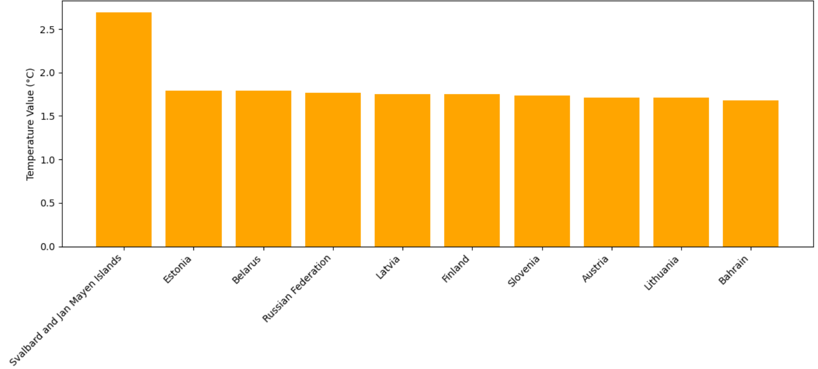
Top 10 Areas With The Highest Temperature Change

Slide 12
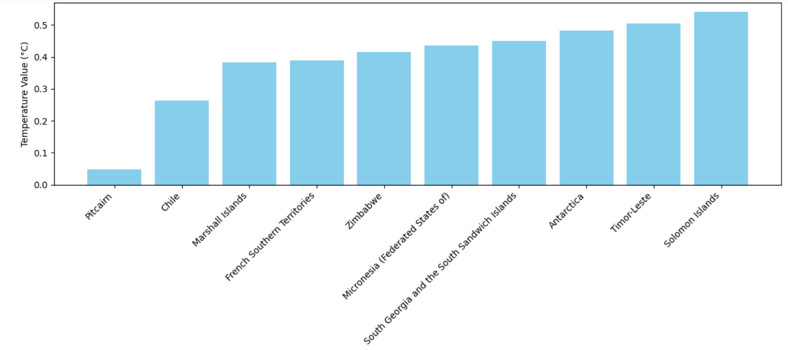
Top 10 Areas With The Lowest Temperature Change

Slide 13
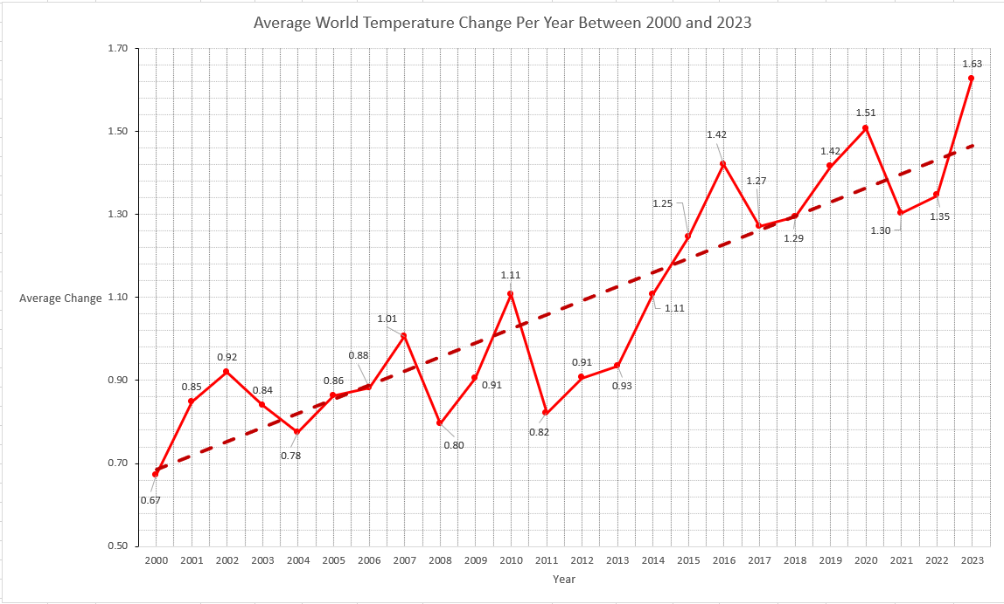
Average Year Temperature Change per Year 2000-2023

Slide 14
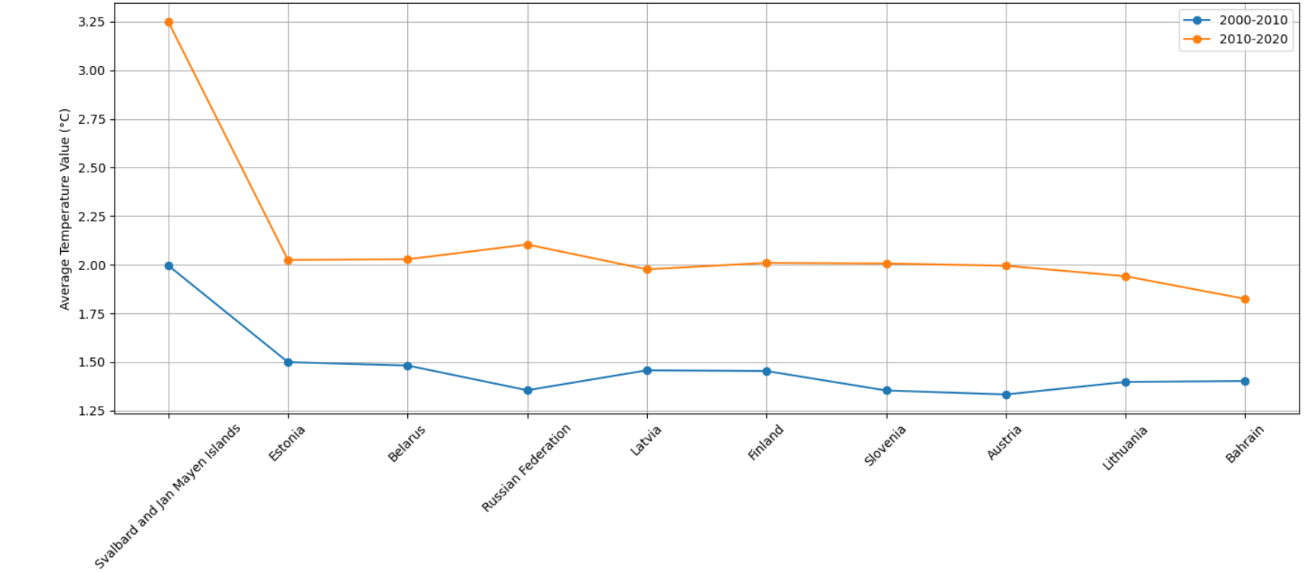
Average temperature change for the 10 top Areas in two decades:

Slide 15
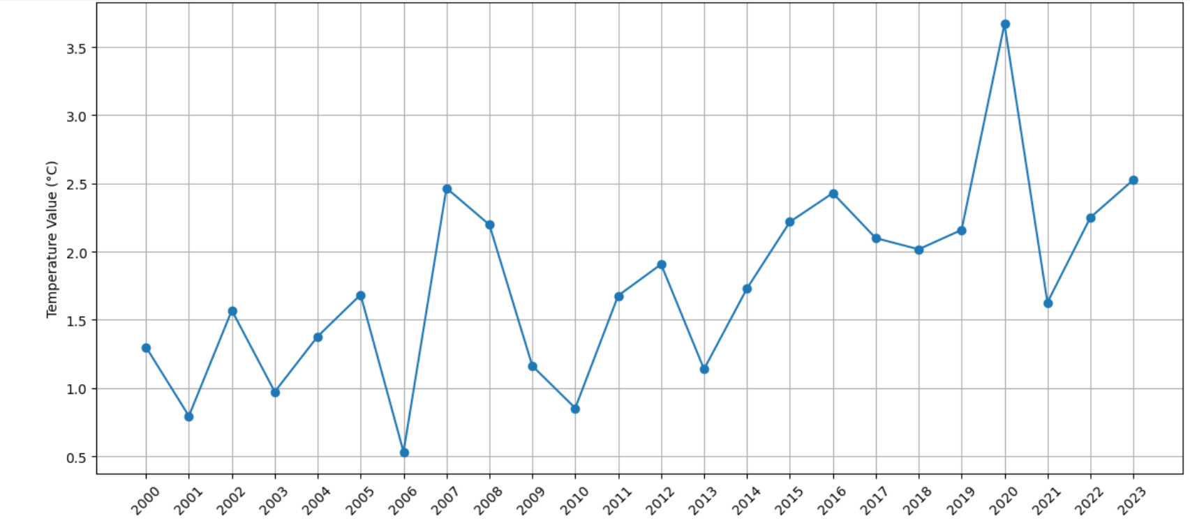
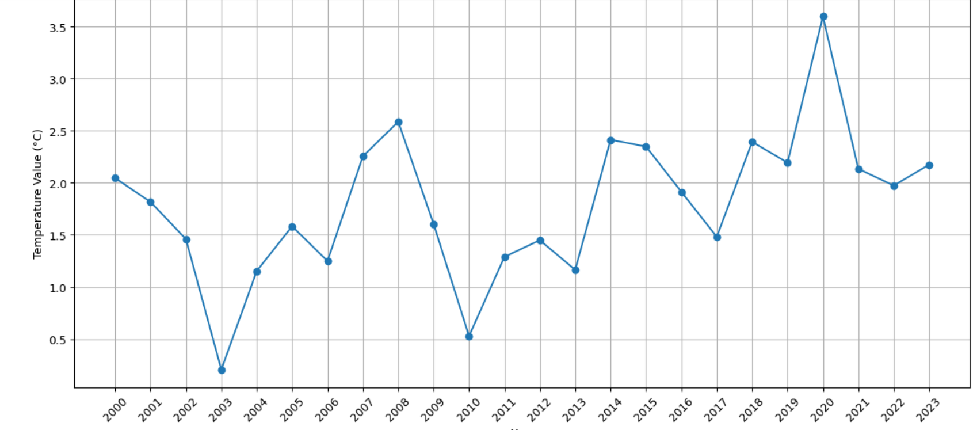
Temperature Change throughout the years ( Russian Federation and Estonia)

Slide 16
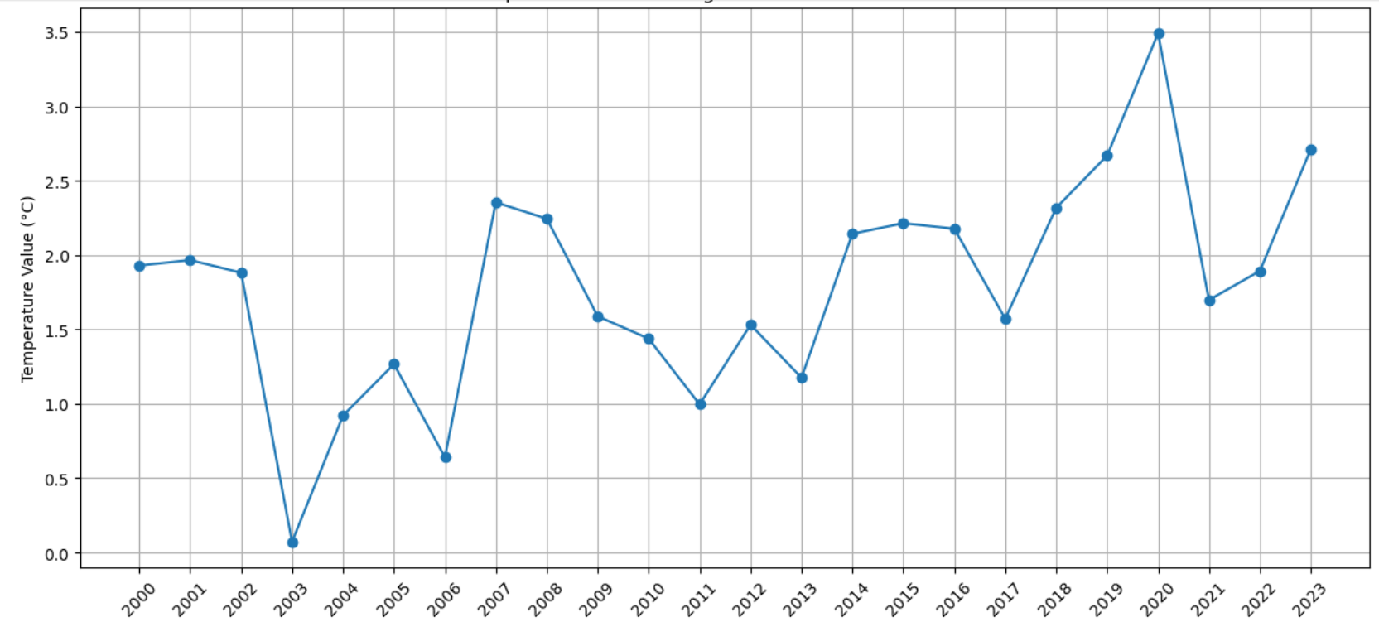
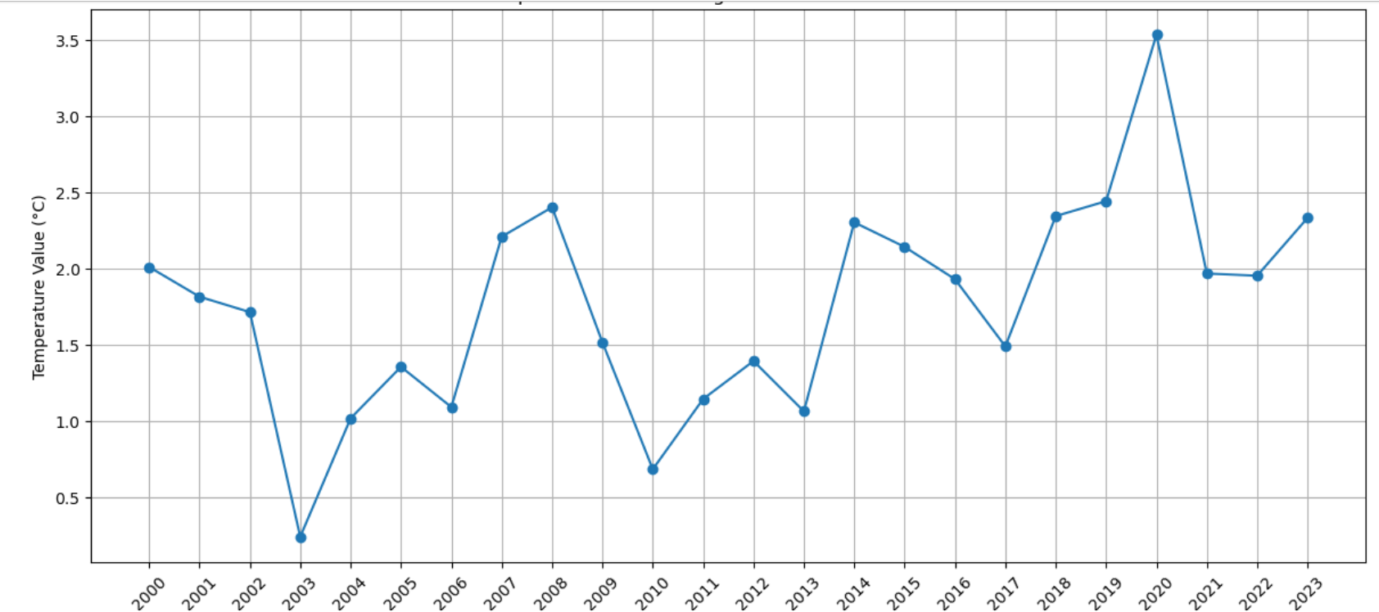
Belarus and Latvia

Slide 17
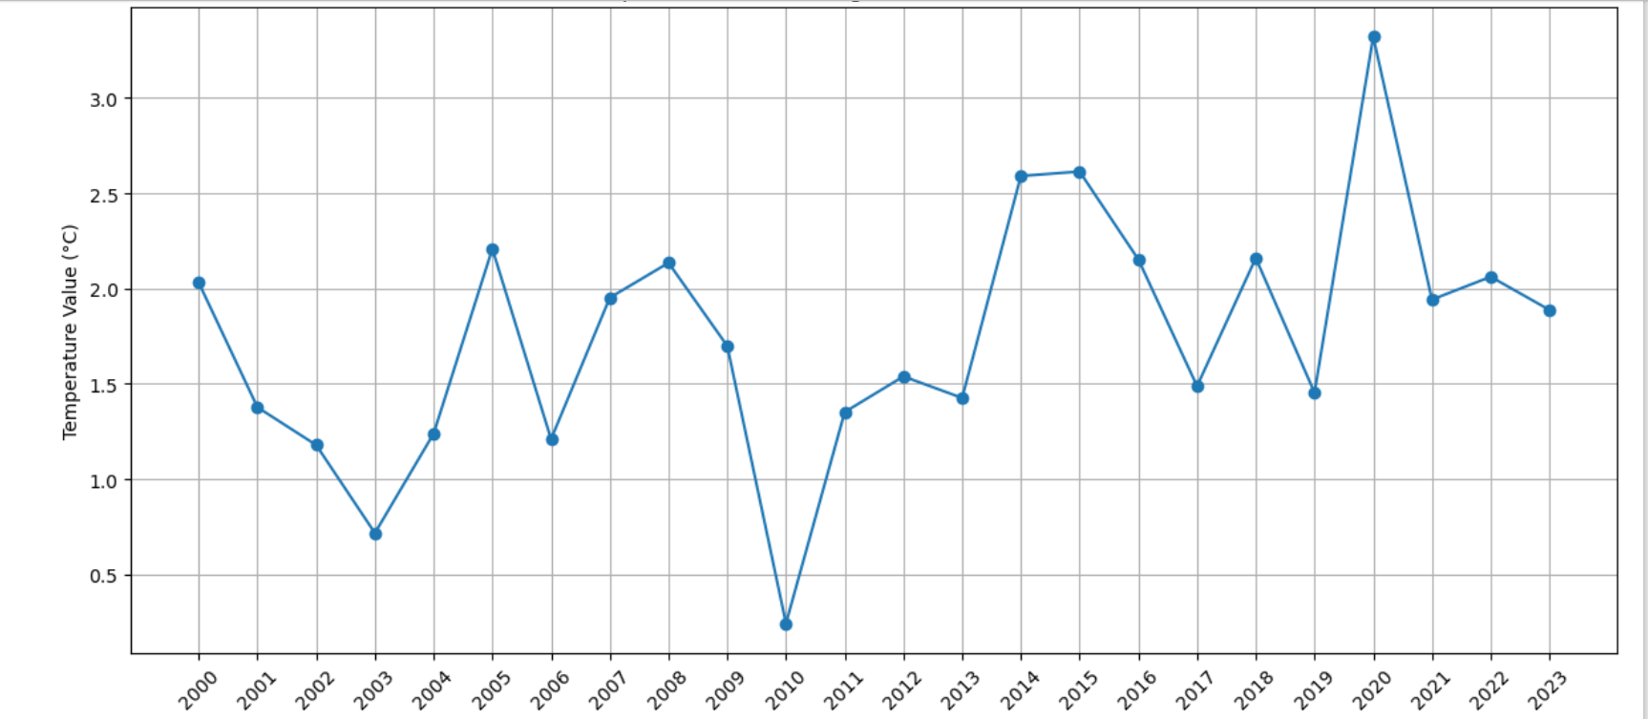
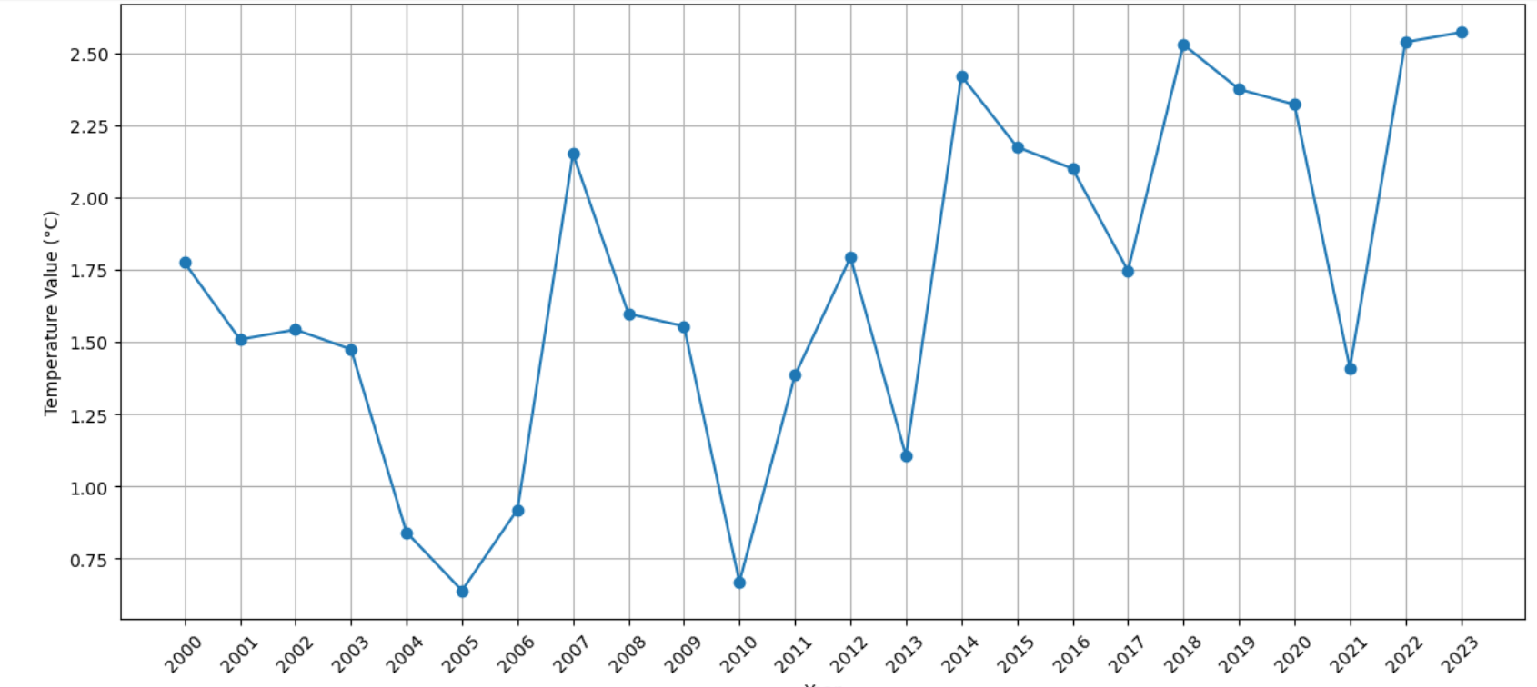
Finland and Austria

Slide 18
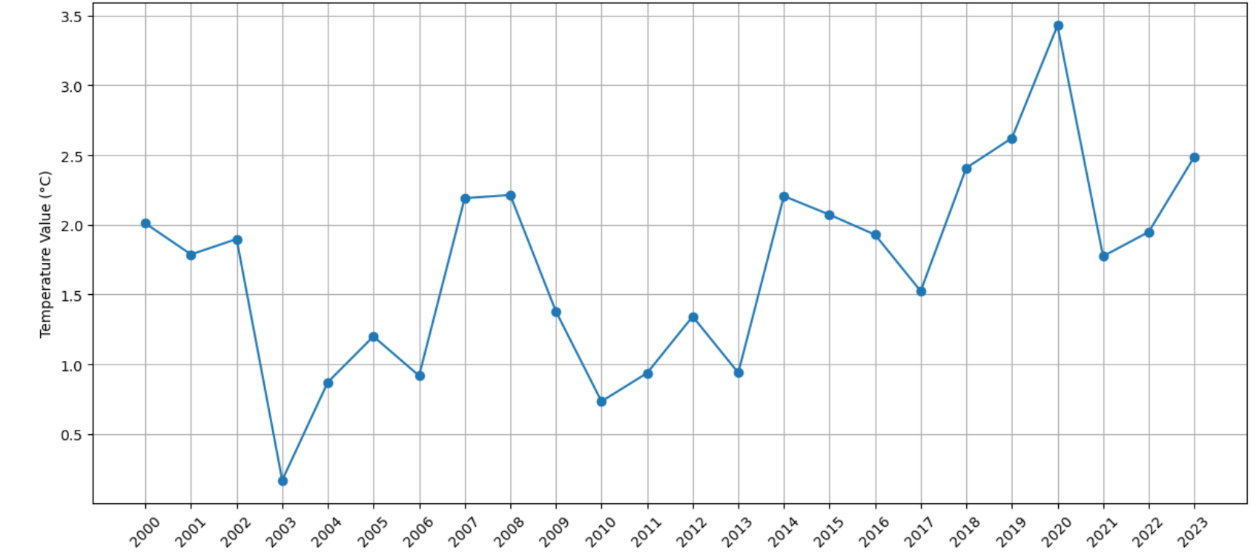
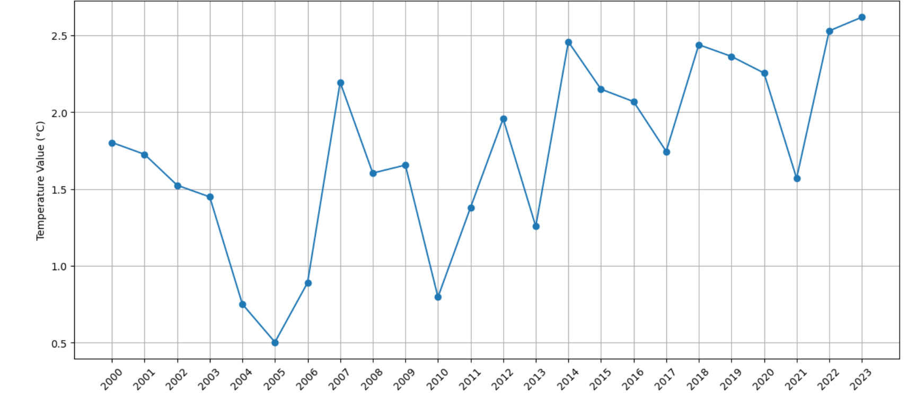
Lithuania and Slovenia

Slide 19
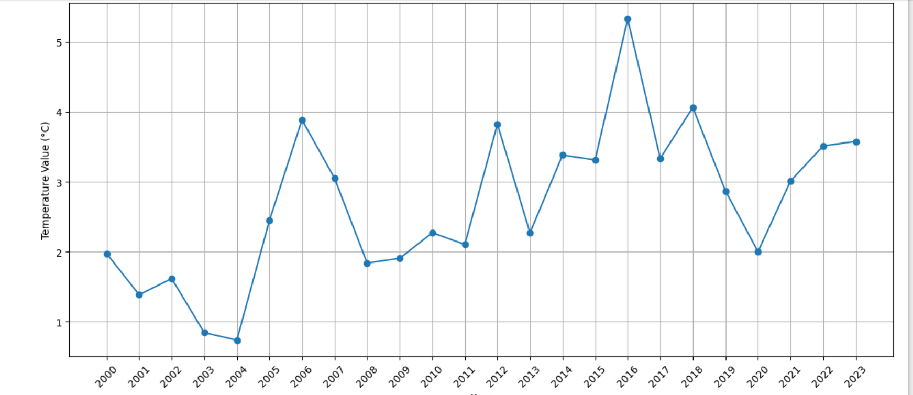
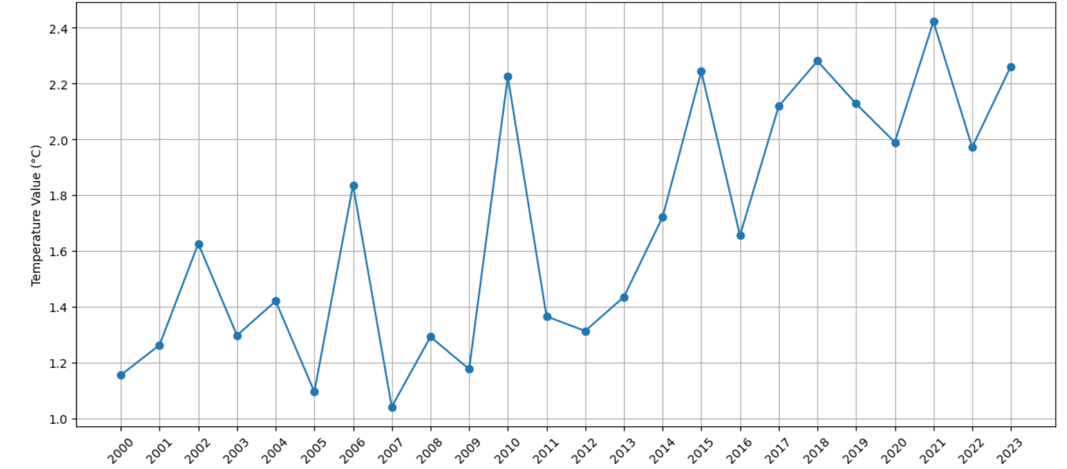
Russian Federation and Bahrain

Slide 20
Interesting Findings
Highest temperature change occurred in the far Northern Hemisphere (Svalbard and Jan Mayen Islands) known as the polar amplification.
Lowest temperature change occurred in the least populated areas.

Slide 21
Challenges
Finding an appropriate dataset
Producing the charts
Producing the Cartopy map

Slide 22
Thank You!

